Slide 1


Every thing of AI
Alex Liu @Accenture China
Feb 2024

Slide 3
Index
General Introduction of AI/ML/DEEP Learning
Deeping Learning 核心原理
Deeping Learning 的主要架构以及使用场景
AI的趋势阐述
Generative AI 的分析
相关工具和资源

Slide 4
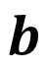
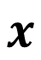
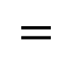
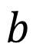
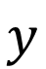

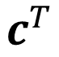
ML is more simple in 3 steps
Step 1: function with unknown
Step 2: define loss from training data
Step 3: optimization
$$y$$
$$=$$
+
+
$$W$$
$$x$$
$$σ\left( \right)$$
$$b$$
$$c^{T}$$
$$b$$
Even more variety of models …

Slide 5
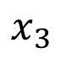
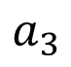
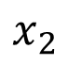
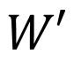
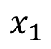
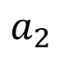
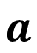
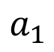
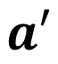
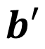
Layer ->Neuron-> Multiplate Layers -> Deep Learning
+
$$a_{1}$$
+
$$x_{1}$$
1
1
$$x_{2}$$
+
$$a_{2}$$
+
1
or
1
$$x_{3}$$
……
+
$$a_{3}$$
+
1
1
$$a′$$
+
$$a$$
$$a$$
+
$$x$$
$$σ\left( \right)$$
$$σ\left( \right)$$
$$W′$$
$$W$$
$$=$$
$$b′$$
$$b$$

